Slide 1
Federated Identity & Authentication Workshop
October 22, 2014

Slide 2
Today’s Agenda
1:00 Welcome and Introductions 5m Evans, Beadles
1:05 Purpose and Goals 5m Beadles
1:10 The Problem Today 15m Beadles
1:25 Basics of Federation 20m Beadles
1:45 Elements of the System 30m Beadles
2:15 Implementation Options 30m Cantor
2:45 Break 15m
3:00 The Ohio Landscape 25m All
3:25 Solution Requirements 25m All
3:50 Call to Action 10m Beadles
4:00 Dismissal

Slide 3
Welcome & Introductions

Slide 4
Purpose & Goals

Slide 5
Purpose & Goals
Displace legacy access and authentication methods which have become dangerously obsolete
Enable OhioLINK members to adopt more secure, extensible authentication framework with OH-TECH's assistance
Lay stepping stones to broader adoption
Define program, answer questions, recruit participants

Slide 6
IAM Ohio Program Overview
IAM Ohio: “A Network of Trust”
Identity & Access Management for Ohio Public-Serving Institutions
Education and Collaboration
Program Goals
Integrating Research at State and Federal level
Enabling Shared Services: OhioLINK, BOR, EduRoam
Improving Provisioning for automation and efficiency
Enhancing the Classroom and Online Teaching

Slide 7
IAM Ohio Program
Standard agreements/alignments with federation providers
InCommon
Eduroam
Education & Training
Vendor management
Vendor identification, testing, pilots
Development of favorable vendor business terms
Federation operations
Definition of regional policies and standards
Establishment of IDM operations, appropriately scaled, supporting high levels of trust and assurance

Slide 8
The Problem Today

Slide 9
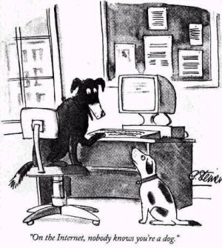
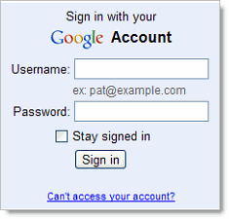
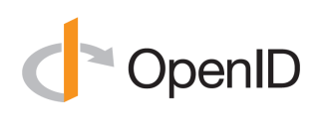
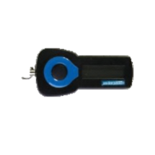
The Identity Crisis
username/ password
Today
Govern-ment issued ID
Student ID
“On the Internet, nobody knows you’re a dog.”

Slide 10
The Identity Crisis
Multiple logins, multiple passwords
Lack of access to applications and services
Privacy breaches, fraud, theft and noncompliance
Lack of trust in identity and privacy claims
Disconnected silos of information
Duplicated effort and expense

Slide 11
Ohio Federation Adoption 10/14
OH-TECH Member | InCommon Member | InCommon Certs | InCommon Auth | OhioLINK via SAML | Eduroam Member | Active Eduroam
34 | 23 | 17 | 11 | 9 | 8 | 1
Ashland |  |  |  |  | •
Bowling Green
Case Western | • | • | • | • | • | •
Cedarville | • |  | • | • | •
Cleveland State |  |  |  |  | •
Columbus State | • | •
Denison | • | •
Eastern Gateway
Franklin | • | •
Hebrew Union
John Carroll
Kent State
Kenyon | •
Lorain County | • | •
Marietta
Miami | • | • | • | • | •
Oberlin | • | •
Ohio Northern | • | •
Ohio State | • | • | • | • | •
Ohio University | • | • | • | •
Owens | • | •
Stark State | • | • | • | •
U of Akron | • |  | • |  | •
U of Cincinnati | • | • | • | • | •
U of Dayton | • | • | • | •
U of Findlay | •
U of Mt Union
U of NW Ohio | • |  | •
U of Rio Grande | • | •
U of Toledo
Walsh | •
Wittenberg
Wooster | • | • | • | •
Wright State | • | •
KEY
InCommon
Member: Vetted member in good standing
Certs: Subscribes to InCommon cert service
Auth: Operates an InCommon IDP
OhioLINK via SAML: Authenticates users to Library services through SAML
Eduroam
Member: Listed by Eduroam: Initiated membership process or testing
Active: Authenticating users to wireless
Notes:
Most Ohio InCommon members are buying certs, not authenticating
Most members authenticate to library services using legacy protocols
“Open” wireless is more common than Eduroam

Slide 12
Barriers to Federation
We don’t have the time to set it up / operate it
We don’t have staff with the right expertise
It costs too much
We don’t have the right software tools
It’s too complex to integrate
We don’t have servers or data centers to run it in
We are challenged by Governance/Policy management
It will disrupt our users
It will disrupt our business
There is no reason to care

Slide 13
Basics of Identity Federation

Slide 14
Building Blocks of Federation
Identity Providers
identity management systems storing the user identity data
Service Providers
collaboration, research, education tools, sites, services
Federation Providers
In USA: InCommon for higher education and research
Notes:
Mark

Slide 15
Notes:
Mark

Slide 16
How Trusted Identity Federation Works
User requests access to App
SP contacts User’s IDP
IDP authenticates User
User requests access to App
User requests access to App
SP contacts User’s IDP
IDP authenticates User
IDP tells SP of result
User requests access to App
SP contacts User’s IDP
IDP authenticates User
IDP tells SP of result
SP provides access to app
User requests access to App
SP contacts User’s IDP
IDP
SP
user
App
pass
User
*IDP: Identity Provider
*SP: Service Provider

Slide 17
How Trusted Identity Federation Works with Proxy
User requests access to App
SP contacts User’s IDP
IDP authenticates User
User requests access to App
User requests access to App
SP contacts User’s IDP
IDP authenticates User
IDP tells SP of result
User requests access to Content
SP contacts User’s IDP
IDP authenticates User
IDP tells SP of result
Proxy provides access to Content Provider
User requests access to App
SP contacts User’s IDP
IDP
SP
user
SAML Proxy
pass
Content Provider
User
*IDP: Identity Provider
*SP: Service Provider

Slide 18
Trust is the foundation
Passwords are never disclosed
Institution that issues identity performs the authentication
Only authorized attributes are released
Multiple levels of trust depending on sensitivity of data
Collaborate only with trusted partners

Slide 19
Elements of the System

Slide 20
Shibboleth is not SAML is not InCommon is not IAMOhio

Slide 21
Elements of the System
SAML
Security Assertion Markup Language, a standard protocol for exchanging security claims and attributes with trust and security
Shibboleth
Open-source software that implements SAML for web access
InCommon Federation
A group of mutually trusting institutions, defined in SAML metadata, that use SAML to federate access
Incommon
The entity that runs the InCommon Federation and also provides related services like certs, training, standardization, organizational vetting
IAMOhio
A community of interest of OH-Tech members with a requirement to federate access regionally as well as with non-OH-Tech members; not limited to SAML

Slide 22
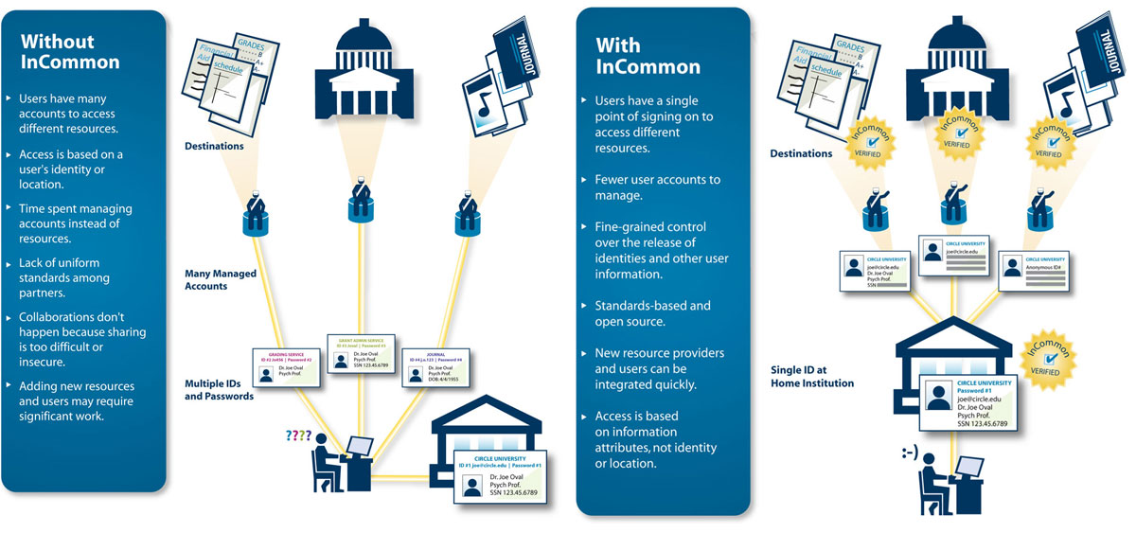

Slide 23
Elements of the System
Attribute
A single piece of user data (such as name, affiliation, study branch, etc.) needed to make authorization decisions. Some attributes are general; others are personal. Some combination of attributes defines a unique individual.
Attribute Schema
eduPerson
Attribute Release Policy
Defines which attributes are going to be released to a requesting resource. It is a mechanism to implement privacy and data protection
Discovery Service (Where Are You From?)
A service that helps a user locate his or her "home" IdP

Slide 24
Current InCommon Sponsored Partners Reference: http://www.incommon.org/participants/ Updated: 10/2014
12Twenty Inc.
9STAR
Aastra USA
Academic Works, Inc.
Acatar
Accessible Information Management, LLC
Active Network
Advantage Connect Pro Inc.
ALEKS Corporation
Alexander Street Press
AliveTek
American Psychological Association
AppointLink Portal Solutions, Inc.
ARTstor
Association for Computing Machinery
AT&T Services
AthenaOnline.com
Atlas Systems, Inc.
Atomic Learning
Axiom Education
Benelogic
BioOne, Inc.
BioRAFT
Blackboard, Inc.
Blatant Media Corporation
Blue Jeans Network
BoardEffect
Box, Inc.
Cambridge University Press
Campus Quad
CampusGuard
Cayuse, Inc.
Cengage Learning, Inc.
CENIC
Center for Research Libraries
CenturyLink
Cincinnati Children's Hospital Medical Center
Cirrus Identity, Inc.
Cloudpath Networks
CollegeNET
Colorado Alliance of Research Libraries
Comodo
CounterMarch Systems
CourseNetworking
Coursera
CourseSmart
CSO Research, Inc.
Data 180,LLC
Davie County Schools
Decision Lens
Desire2Learn
DigArc
Digital Measures
Do Sports Easy
DocuSign
DoubleMap Inc.
Dropbox
Durham Public Schools
e-academy, Inc.
e2Campus by Omnilert, LLC
Ebook Library - EBL
EBSCO Publishing
Echo360
Edublogs
EDUCAUSE
Elsevier
Ensemble Video
Entigence Corporation
eRezLife Software
ESM Solutions
Evanced Solutions, LLC
Evogh, Inc.
Ex Libris
First Advantage Screening Corporation
Fluidware Corporation
Fundriver, Inc.
FuzeBox Software Corp.
GivePulse
Governet
GradesFirst
Great Plains Network
Halogen Software Inc.
Hazelden Betty Ford Foundation
Higher One, Inc.
HighWire Press
Hitachi ID Systems
Houston Academy of Medicine - Texas Medical Center Library
IEEE
iLab Solutions
Imodules Software, Inc.
Innotas
Institute for Advanced Study
Instructure, Inc.
Interfolio, Inc.
JSTOR
Kaltura Inc.
Kuali Foundation
LabArchives
LCMS Plus Inc.
Leepfrog Technologies, Inc.
Library of Congress
Logistical Athletic Solutions
Longsight
Lucid Software
lynda.com
Mass. Green High Performance Computing Ctr
Maxient LLC
MCNC
MedHub
MediaCore Technologies Inc.
Merit Network, Inc.
Microsoft
Modo Labs Inc.
Moodlerooms, Inc.
Moofwd Inc
Moxie Software
Mozy, Inc.
MyEvaluations.com Inc.
Myunidays Limited
National Student Clearinghouse
NBC Learn
NC Live
Nolij Corporation
NuPark
OCLC
Ohio Technology Consortium (OH-TECH)
OhioLink - The Ohio Library & Information Network
OmniUpdate
OrgSync. Inc.
Outside The Classroom
Parchment Inc.
Pathbrite, Inc
PeopleAdmin, Inc.
Ping Identity Corporation
Portfolium, Inc.
ProQuest LLC
Publishing Technology
Qualtrics
Rave Mobile Safety
Reeher
RefWorks, LLC
Research Foundation for the SUNY
RightAnswers
Rockingham County Schools
Royal Society of Chemistry
Rsam
SAE International
Safari Books Online
Sallie Mae Campus Solutions
SANS Institute
SciQuest
SCLogic
Seelio
Serials Solutions
ServiceNow
SHI International Corp.
Skillsoft Corporation
Springshare
SSB Bart Group
Stoodify
Stryder Corp
Student Success
SumTotal Systems Inc.
Symplicity Corporation
TeamDynamix Solutions, LLC
TERENA
Terra Dotta
The Beans Group
The CBORD Group
The Centre Daily Times
The Solution Design Group, Inc.
Thomson Reuters
Tivli
Toopher
Top Hat Monocle
Travel Solutions, Inc.
Trondent Development Corp.
Trumba Corporation
Turnitin
Ubiquia Inc.
UHC
Unicon, Inc.
United Public Safety
University of Arkansas, Cooperative Extension Service
University of Texas Health Science Center At Tyler
UniversityTickets
UPIC Solutions
Upswing International, Inc.
VoiceThread
Washington Research Library Consortium
WebAssign
WEPA, Inc.
Woofound
Yammer
Zimride, Inc.

Slide 25
Implementation Options

Slide 26
Alternative Identity Provider Strategies
Source: InCommon Alternate IdP Working Group, https://spaces.internet2.edu/display/altidp
IdP Strategy | Description
Shibboleth | Mainstream SAML implementation Open source via Shibboleth Consortium
Microsoft ADFS (Active Directory Federation Services) | Natural approach for Windows shops Proprietary as part of Active Directory
SimpleSAMLphp | Lightweight PHP-based IdP Open source via Uninett (NO)
Outsourced Shibboleth | 3rd party hosted Shibboleth IdP e.g. Fischer Identity Ignite Federation
Outsourced other vendor | 3rd party hosted non-Shib SAML IdP e.g. Cirrus Bridge Social-to-SAML Gateway
Hub-and-spoke | Group of organizations sharing a trusted IdP e.g. WAYF (DK), SURFnet (NL), FEIDE (NO)
Identity-as-a-Service | Outsource all or nearly all of IDMS e.g. Stormpath, Okta, Google, Fischer Suite

Slide 27
Break

Slide 28
The Ohio Landscape
(handout)

Slide 29
Solution Requirements Discussion

Slide 30
Call to Action

Slide 31
“Federation Package”
Federated Services
OhioLINK library system access
Eduroam roaming wireless
State Board of Regents Services
Higher education student database
Supercomputing access
OARnet Customer Portal access
OH-Tech Federation Package
SAML server in a box? (Shib/ADFS/Fischer…?)
Technical assistance/training (Shibfest II?)
Funding? Time? Personnel?
Standards
Ohio “Category” a la R&S

Slide 32
Federated Identity & Authentication Workshop
October 22, 2014

